Slide 1
Basic Java
Unit 2 – Language Fundamentals

Slide 2
Topics
Keywords
Identifiers
Data Types
Literals
Type Conversion
Formatted Output
Operators
Comments
Conditional Constructs
Looping Constructs
Break and Continue
Processing Arrays
Recursion

Slide 3
Keywords
Keywords are standard words that constitute Java.
  Have pre-defined meaning and cannot be redefined.
  Are always in lowercase.
There are about 50 keywords in Java.

Slide 4
Identifiers
Identifiers are user-defined names that are given to variables, functions, arrays, classes, etc.
Naming Rules

Slide 5
Data Types
Data type determines the values that a variable can contain and the operations that can be performed.
Two types:
  Primitive Types
  Reference Types

Slide 6
Primitive Types
There are eight primitive types in Java.
Primitive type | Size
boolean | 1-bit
char | 16-bit
byte | 8-bit
short | 16-bit
int | 32-bit
long | 64-bit
float | 32-bit
double | 64-bit
The size of these data types are independent of the platform.

Slide 7
Literals
Literals are values assigned to identifiers.
Examples of literals:
  3L
  Long literals take constant L.
  100
  Integer literal
  98.6 or 98.6D
  Double literals optionally take double constant D.
  98.6f
  Float literals take floating point constant f.
  ‘A’
  Character literals are enclosed in ‘ ’.
  “This is a test”
  String literals are enclosed in “ ”.

Slide 8
Declaring Variables
General format of variable declaration: type var1, var2,…… varN;
Few examples:
  int num1, num2, sum;
  char ch;
  double x, y;
You can also initialize the variables at the time of declaration:
  int a = 10 , b = 20;
  char ch = ‘A’;
Sample Code : PrimitiveDemo.java

Slide 9
Knowledge Check
Question
Write a program to swap the values of two numbers. Display the numbers before swapping and display them again after values are swapped.

Slide 10
Type Casting of Primitives
A primitive of one data type can be cast to another data type in Java.
  Casting is possible, if the two data types are compatible.
  Casting is implicit, if destination type is larger than source type.
  Casting needs to be explicit, if the destination type is smaller than source type. This may lead to loss of data.
Sample Code : PrimitiveTypeCast.java

Slide 11
Knowledge Check
Question
Write a program to extract the whole and decimal parts of a fractional number by developing a ‘DecimalSplitter’ class with methods:
    getWhole(double d): Contains logic of extracting the whole part of d
    getFraction(double d): Contains logic of extracting the fractional part of d

Slide 12
The ‘String’ data type
Management of data containing multiple characters can be done through a String object
The built-in library class ‘String’ provides support for representing string
of characters and performing basic operations on them.
Concatenation of strings is done by using the ‘+’ operator.
Sample Code : StringDemo.java

Slide 13
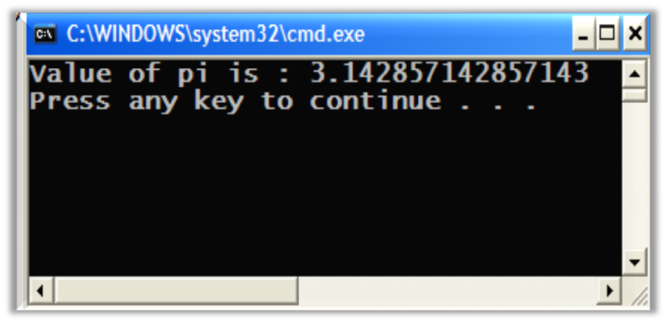
Formatted Output
Consider the below code and its output:
class Unformatted
{
public static void main(String[] args)
{
double pi = 22.0/7;
System.out.println ("Value of pi is : " + pi);
}
}
What if you want to display the value as 3.143?

Slide 14
Formatted Output
Java 1.5 introduces the C-style printf() method for making formatted output.
System.out.printf() method lets you format a string, in accordance with a format specifier, before making an output on the console.
Each argument to be formatted is described by using a string that begins with % and ends with the formatted object's type.
Simplest overloaded form of this method:
  printf (String format, Object... args)
  printf (“%d”,i) // where i is an integer
Most of C’s string formats are available in Java.

Slide 15
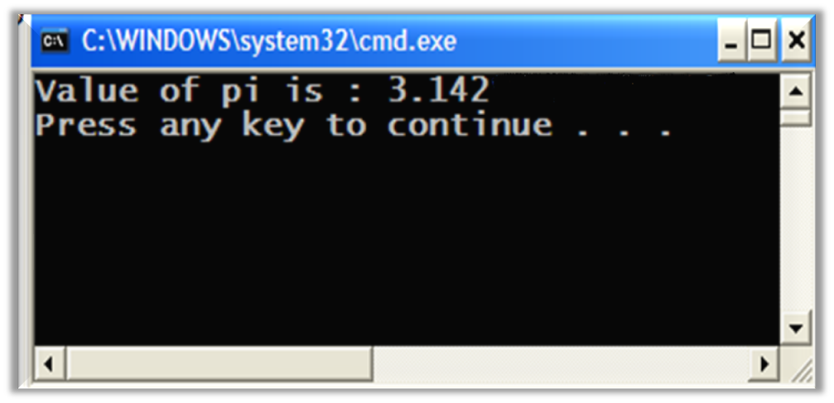
Formatted Output
class Unformatted
{
public static void main(String[] args)
{
double pi = 22.0/7;
System.out.printf ("Value of pi is : %.3f" + pi);
}
}

Slide 16
Formatted Output
The table below lists some important format specifiers:
Specifier | Description
%n | Outputs the line separator for the platform
%d | Formats the value as a base-10 integer Arguments must be Byte, Short, Integer, and Long
%f | Formats the value as a floating-point number in base-10 without exponential notation Arguments must be Float or Double
%e | Formats the value as a base-10 floating-point number by using exponential notation Arguments must be Float or Double
%% | Escape sequence to allow printing of % in a String
%c | Formats the value supplied as a single character Supplied value must be a Byte, Short, Character, or Integer

Slide 17
Formatted Output
System.out.format() method performs the same function as System.out.printf() and they can be used interchangeably.
For a complete list of all format specifiers, please refer to java docs for class Formatter.
Sample Code : PrintfDemo.java

Slide 18
Java Language Operators
Operators are used to perform a function on variables.
Types of Operators | Description | Examples
Unary
Binary
Ternary
Arithmetic
Relational and Conditional
Bitwise and Logical
Assignment
Requires only one operand
num++;
Requires two operands
num1 = num2;
Requires three operands
num1>0 ? num1=100 : num1=200;
Is used for all floating-point and integer numbers
+ (addition), - (subtraction), * (multiplication), / (division), and % (modulo)
Relational operator compares two values and determines the relationship between them.
Relational: >, <, <=, >=, ==, !=
Conditional: &&, ||
Bitwise operator allows you to perform bit manipulation on data;
Bitwise: <<, >>, |, &, ^, ~
Is used to assign one value to another
=
Notes:
The Java language provides a set of operators which is used to perform a function on one or two variables. Operators perform some function on either one or two operands or three operands.
Operators that require one operand are called unary operators. For example, ++ is a unary operator that increments the value of its operand by 1. Operators that require two operands are binary operators. For example, = is a binary operator that assigns the value from its right-hand operand to its left-hand operand. And finally ternary operators are those that require three operands. The Java language has one ternary operator, ?:, which is a short-hand if-else statement.
In addition to performing the operation, an operator also returns a value. The value and its type depends on the operator and the type of its operands. For example, the arithmetic operators, which perform basic arithmetic operations such as addition and subtraction, return numbers-the result of the arithmetic operation. The data type returned by the arithmetic operators depends on the type of its operands: If you add two integers, you get an integer back. An operation is said to evaluate to its result.
It's useful to divide Java's operators into these categories: arithmetic; relational and conditional; bitwise and logical; and assignment.
Arithmetic Operators
The Java language supports various arithmetic operators for all floating-point and integer numbers: + (addition), - (subtraction), * (multiplication), / (division), and % (modulo).
Relational and Conditional Operators
A relational operator compares two values and determines the relationship between them. Some of them are >, <, <=, >=, ==, !=.
Java supports five binary conditional operators.They are &, |, !, &&, ||.
Bitwise and Logical Operators
A bitwise operator allows you to perform bit manipulation on data. They are <<, >>,>>>, |, &, ^, ~.
Assignment Operators
The basic assignment operator is = which is used to assign one value to another.

Slide 19
Operator Precedence
The operators in this table are listed in precedence order: the higher an operator appears, the higher its precedence.
Operators with higher precedence are evaluated before operators with a relatively lower precedence.
Operators on the same line have equal precedence.
Operators | Examples
postfix | [ ] . (params) expr++ expr-
unary | ++expr –expr +expr –expr ~ !
creation or cast | New (type)expr
multiplicative | * / %
additive | + -
shift | << >>
relational | < > <= >= instanceof
equality | == !=
bitwise AND | &
bitwise exclusive OR | ^
bitwise inclusive OR | |
logical AND | &&
logical OR | ||
conditional | ? :
assignment | = += -= *= /= %= &= ^= |= <<= >>=
Notes:
An expression is a series of variables, operators, and method calls (constructed according to the syntax of the language) that evaluates to a single value. The evaluation of the expression depends on the precedence assigned to the operators and other elements in use within the expression. Operators with a higher precedence get evaluated first. For example, the division operator has a higher precedence than does the addition operator so, in the expression, x + y / 100, the compiler would evaluate y / 100 first. Thus x + y / 100 is equivalent to x + (y / 100).
The operators in this table are listed in precedence order: the higher in the table an operator appears, the higher its precedence. Operators with higher precedence are evaluated before operators with a relatively lower precedence. Operators on the same line have equal precedence.

Slide 20
Knowledge Check
Question
Evaluate the following expression: a + b – c * d / e, wherein a = 2, b = 2,
c = 1, d = 3, and e = 10.

Slide 21
Knowledge Check
Question 2
Write a program to accept a number and display whether a number is odd or even using the ternary operator.
Question 2
Find the largest of three numbers using ternary operator:
Develop a ‘LargestFinder’ class with the following method:
public int getLargest (int num1, int num2, int num3)
  Also, write the logic of finding the largest of three numbers using the ternary operator.

Slide 22
Comments
Three kinds of comments:
Double slashes
  // Single line comment
C-style
  /* C-style comment
  Is used to comment out multiple lines */
Javadoc comments
  Used to generate documentation
  /** This class displays a text string at
  * the console.
  */
Notes:
Code Comments
Code comments are placed in source files to describe what is happening in the code to someone who might be reading the file, to comment-out lines of code to isolate the source of a problem for debugging purposes, or to generate API documentation.
Double Slashes
Double slashes (//) are used in the C++ programming language, and tell the compiler to treat everything from the slashes to the end of the line as text.
//A Very Simple Example
C-Style Comments
Instead of double slashes, you can use C-style comments (/* */) to enclose one or more lines of code to be treated as text.
/* These are
C-style comments */
Doc Comments
To generate documentation for your program, use the doc comments (/** */) to enclose lines of text for the javadoc tool to find. The javadoc tool locates the doc comments embedded in source files and uses those comments to generate API documentation.
/** This class displays a text string at
* the console.
*/

Slide 23
Javadoc Comments
Sample Javadoc comments:
/** This program is to demonstrate the use of javadoc tool
@author Sindhu
*/
public class JavaDocDemo
{
/** This variable holds the value of the computed sum */
public static int sum = 0;
/** This is the main() method
This is the point at which execution starts */
public static void main(String[] args)
{
for(int i=1;i<=5;i++)
sum = sum + i;
System.out.println(sum);
}
}

Slide 24
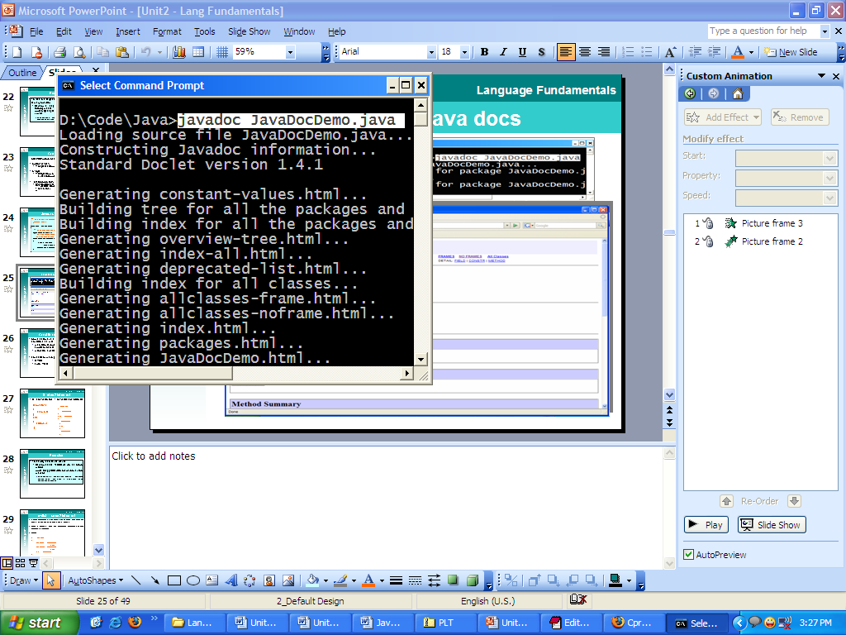
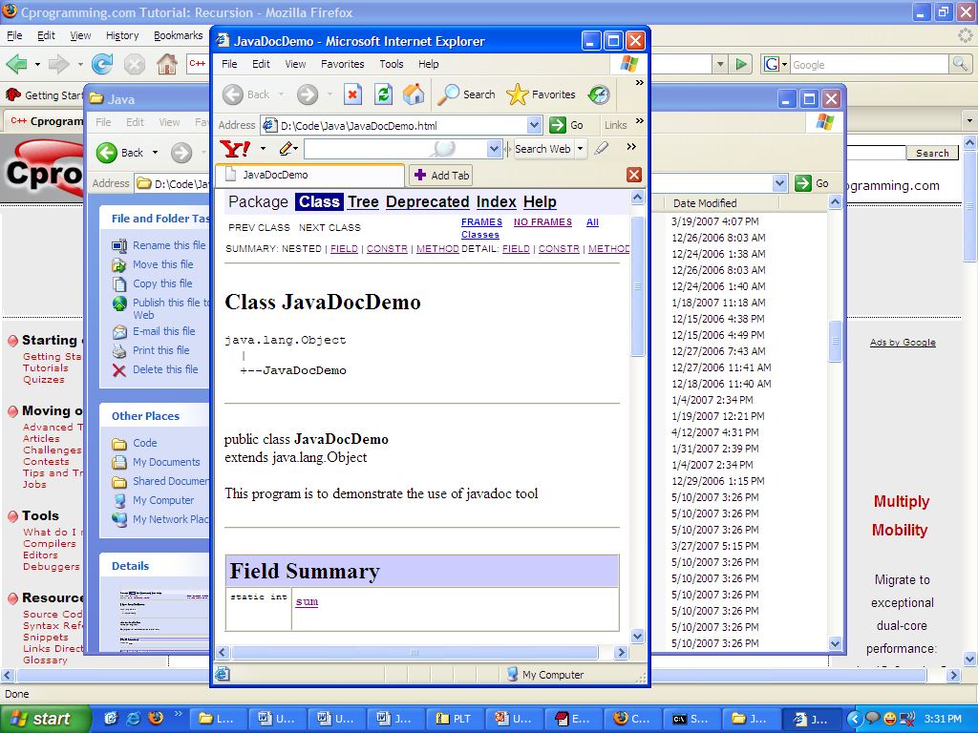
Generating Java Docs
The generated HTMLs follow a standard format defined by Sun Microsystems.
All of Java’s built-in classes are documented similarly.

Slide 25
Conditional Statements
Some statements are executed only if certain conditions are met
  A condition is represented by a logical (Boolean) expression that has a value of either true or false.
  A condition is met, if it evaluates to true.
For decision making:
  if – else
  switch – case

Slide 26
if-else Statement
if – else statement
  if (condition)
  {
  statements
  }
  else
  {
    statements
}
Nested if–else statement
  if (condition)
  {
  statements
  }
  else if (condition)
  {
    statements
}
else
{
statements
}

Slide 27
Knowledge Check
Question
Display a student’s result by:
developing a class ‘TestResult’ with the following method
public String getResult( int marks, int marks2, int marks3).
  Write the logic of returning the result as ‘First Class’, ‘Second Class’, ‘Pass Class’, or ‘Fails’ based on the average marks secured.

Slide 28
switch –case Statement
A switch statement is a multi-way decision maker that tests the value of an expression against a list of values.
When a match is found, the statements associated with that value are executed.
Note:
Variable can only be of type int, short, byte, char or enum.
Syntax:
switch(variable)
{
case value-1 : statements
break;
case value-2 : statements
break;
default : statements
}

Slide 29
Structured Loops
A loop maybe defined as a set of statements that are repeatedly executed.
A loop permits the repeated execution of a sequence of statements while some condition is true.
There are three types of loops:
  while loop
  do…while loop
  for loop

Slide 30
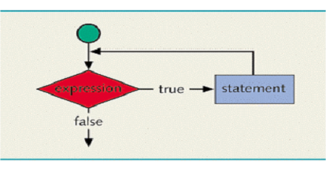
while Loop
The general form of the while statement is:
while(expression)
{
statement….
}
The loop is entered when the expression is true.
The loop is terminated when the expression is false.
This is a pre-tested loop.
This loop need not be compulsorily executed once.
int i =1;
while(i<=10)
{
System.out.print(i+“\t”);
i++;
}

Slide 31
Knowledge Check
Question
Display a number in words by:
developing a class ‘NumToWordsConverter’ with the following method
public String numToWords(int number).
  Write the logic of constructing a string that represents the number in words.

Slide 32
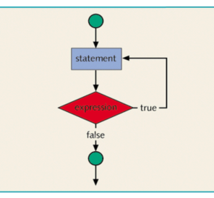
do… while Loop
The general form of the do…while statement is:
do
{
statement….
} while(expression);
This loop will be executed at least once.
The loop is re-entered when the expression is true.
The loop is terminated when the expression is false.
This is a post-tested loop.
int i =1;
do
{
System.out.println(i);
i++;
} while(i<=10);

Slide 33
Knowledge Check
Question
Accept user’s choice and perform mathematical computation.

Slide 34
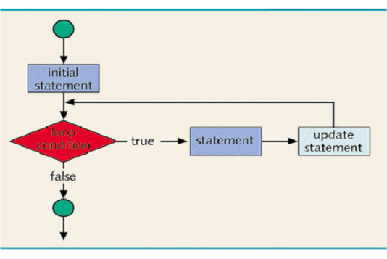
for Loop
The general form of the for statement is:
for (init counter; testcondition; re-valuation counter)
{
statement…..
}
Steps involved in execution:
The initial statement executes.
The loop condition is evaluated.
If the loop condition evaluates to true:
  execute the for loop statement.
  execute the update statement (the third expression in the parentheses).
Repeat the previous step until the loop condition evaluates to false.
for(int i=0;i <=10;i++)
{
System.out.println(i);
}

Slide 35
Knowledge Check
Question
Display the following pattern
*
* *
* * *
* * * *

Slide 36
break Statement
The break statement, when executed in a switch structure, provides an immediate exit from the switch structure.
When the break statement executes in a repetition structure, it immediately exits from these structures.
The break statement is typically used for two purposes:
  To exit early from a loop
  To skip the remainder of the switch structure
After the break statement executes, the program continues to execute with the first statement after the structure.
The use of a break statement in a loop can eliminate the use of certain (flag) variables.
Syntax:
while(condition)
{
statement;
if(condition)
break;
statement;
}
statement;

Slide 37
Knowledge Check
Question
Write a program to find the sum of all the prime numbers in the range n to m. Display each prime number and also the final sum.

Slide 38
continue Statement
The continue statement is used in while, for, and do… while structures.
In a while and do… while structure, the expression (loop-continue test) is evaluated immediately after the continue statement.
In a for structure, the update statement is executed after the continue statement, and then the loop condition executes.
When the continue statement is executed in a loop, it skips the remaining
statements and proceeds with the next iteration of the loop.
Syntax:
while(condition)
{
statement;
if(condition)
continue;
statement;
}

Slide 39
Knowledge Check
Question
Write a program to display the 1st, 2nd, and 4th multiple of 7, which gives the remainder 1 when divided by 2, 3, 4, 5, and 6.

Slide 40
Arrays
Array is a collection of a fixed number of components wherein all of the components are of the same data type.
  It is a homogeneous data type.
Whenever an array is used, the subscript or the index is involved. The value to be stored or retrieved from the array has to be specified by using both the name of the array and the subscript.
0
1
2
3
4
5
6
7
8
9
arr =
5
10
15
20
25
30
35
40
45
50
arr[0] = 5;
System.out.println(arr[0]);
In an array of size ‘n’, the first subscript is always 0 and the last subscript is n – 1.

Slide 41
Declaring an Array
To declare an array that can hold integer values:
NOTE
Without use of ‘new’ keyword, the array is not allocated memory
int[ ] arrayOfInts; // memory not allocated
int arrayOfInts[ ]; // memory not allocated
int[ ] arrayOfInts= new int[10]; // memory allocated
Note: Without use of ‘new’ keyword, the array is not allocated memory.
Arrays can contain any legal Java data type including reference types such as objects or other arrays.
For example, the following declares an array that can contain ten Customer objects:
Customer[ ] arrayOfCust = new Customer[10];

Slide 42
Initializing an Array
We can store values into an array by using the index to specify position:
int a[ ] = new int[5];
a[0] = 10;
a[1] = 20;
a[2] = 30;
a[3] = 40;
a[4] = 50;
An array can also be initialized at the time of declaration:
int iArray[ ] = { 2, 3, 5, 7, 11, 13 };

Slide 43
Accessing Elements of an Array
Elements of an array can be accessed by looping through the array, and accessing the element stored at a particular index:
int[ ] arr = new int[5];
for(int i=0;i<arr.length;i++)
System.out.print(arr[i] + “\t”);
Sample Code : ArrayDemo.java

Slide 44
Knowledge Check
Question
Write a program to store N elements in an array of integer. Display the elements. Accept a number to be searched. Display whether the number is found or not in the array (LINEAR SEARCH).

Slide 45
Multi-Dimensional Arrays
An array where elements can be accessed by using more than one subscript is known as multi-dimensional array.
A two-dimensional array can be logically visualized as a collection of rows and columns, like in a matrix.
[0]
[1]
[2]
a[1][2]
100
200
300
int a[ ][ ] = new int[3][3];
Logically, the array can be
visualized as a 3x3 matrix.
a[0]
400
500
600
a[1]
700
800
900
a[2]
A two-dimensional array requires two subscript for accessing its elements.

Slide 46
Knowledge Check
Question
Check if a given square matrix is identical and / or symmetric by:
  Developing a MatrixWizard class with the following methods:
  public boolean isIdentity(int[ ][ ] matrix)
  (Check if the matrix is identity or not and return a boolean value indicating it
  public boolean isSymmetric(int[ ][ ] matrix)
(Check if the matrix is symmetric or not and return a boolean value indicating it)

Slide 47
Recursion
Recursion is an algorithmic technique where a function/ method, in order to accomplish a task, calls itself with some part of the task.
Example:
public void recurse (int n)
{
System.out.println(n);
recurse(n-1);
}
Method call should terminate at some point, else the recursive method will be called infinitely.
public void recurse(int n)
{
System.out.println(n);
recurse(n-1);
if(n == 0)
return;
}

Slide 48
Recursion
Consider finding the sum of elements in an array from a start index to the last element in the array.
This can be recursively performed.
Sample Code : RecursionDemo.java

Slide 49
Knowledge Check
Question
Find the factorial of a number using recursion by:
  Develop a class FactorialGenerator with the following method
  public int getFactorial(int num)
        Write the logic of finding the factorial by using the technique of recursion.

Slide 50
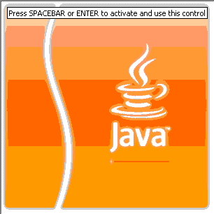

Question time
Please try to limit the questions to the topics discussed during the session. Thank you.

Slide 51
Keywords
Keywords are standard words that constitute Java.
  Have pre-defined meaning and cannot be redefined.
  Are always in lowercase.
There are about 50 keywords in Java.
abstract
abstract
continue
continue
for
for
new
new
switch
switch
assert
assert
default
default
goto
goto
package
package
synchronized
boolean
boolean
do
do
if
if
private
private
this
this
break
break
double
double
implements
implements
protected
protected
throw
throw
byte
byte
else
else
import
import
public
public
throws
throws
case
case
enum
enum
instanceOf
instanceOf
return
return
transient
transient
catch
catch
extends
extends
int
int
short
short
try
try
char
char
final
final
interface
interface
static
static
void
void
class
class
finally
finally
long
long
strictfp
strictfp
volatile
volatile
const
const
float
float
native
native
super
super
while
while

Slide 52

Identifiers
Identifiers are user-defined names that are given to variables, functions, arrays, classes, etc.
Naming Rules
  Only numeric and alphabetic characters are permitted
  Special characters permitted are ‘_’ (underscore) and ‘$’ (dollar)
  Should not start with a digit
  Case-sensitive; uppercase and lowercase letters are distinct
  Keyword cannot be used as a variable name
int age;
class Employee
{
//…
}
void setName(Stringname)
int [ ] scores = new int [10];
Knowledge Check

Slide 53
Knowledge Check
Question
Identify legal and illegal identifiers from the following (state your reasons):
first
Employee Salary
Conversion
Hello!
One+two
$test
2nd
_myName
Employee

Slide 54
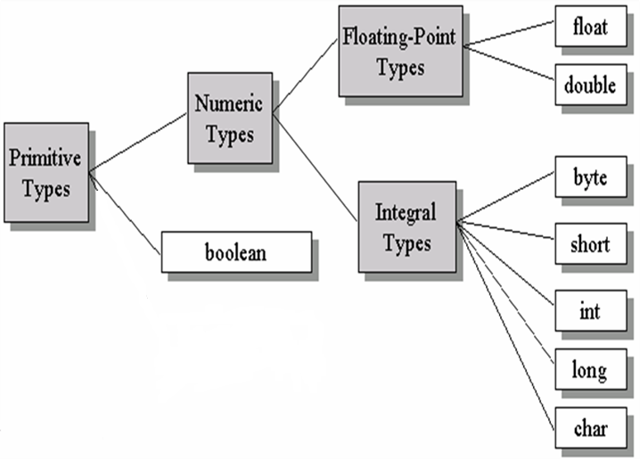
Data Types
Data type determines the values that a variable can contain and the operations that can be performed.
Two types:
  Primitive Types
  Reference Types
Classification
Examples
100
23.667
‘c’
true

Slide 55
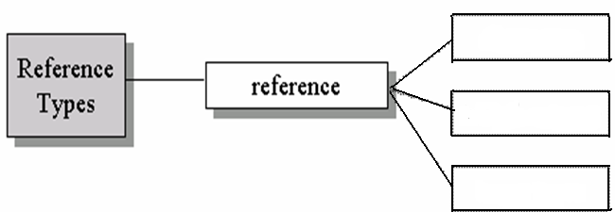
Data Types
Data type determines the values that a variable can contain and the operations that can be performed.
Two types:
  Primitive Types
  Reference Types
Classification
Examples
classes
customer
intArr[ ]
empArr[ ]
interfaces
arrays

Slide 56
Primitive Types
There are eight primitive types in Java.
Primitive type | Size
boolean | 1-bit
char | 16-bit
byte | 8-bit
short | 16-bit
int | 32-bit
long | 64-bit
float | 32-bit
double | 64-bit
The size of these data types are independent of the platform.
boolean
Can take values true or false.
Cannot be used interchangeably with 1 and 0

Slide 57
Primitive Types
There are eight primitive types in Java.
Primitive type | Size
boolean | 1-bit
char | 16-bit
byte | 8-bit
short | 16-bit
int | 32-bit
long | 64-bit
float | 32-bit
double | 64-bit
The size of these data types are independent of the platform.
char
Unicode character set

Slide 58
Primitive Types
There are eight primitive types in Java.
Primitive type | Size
boolean | 1-bit
char | 16-bit
byte | 8-bit
short | 16-bit
int | 32-bit
long | 64-bit
float | 32-bit
double | 64-bit
The size of these data types are independent of the platform.
byte
Takes values in the range -128 to 127

Slide 59
Primitive Types
There are eight primitive types in Java.
Primitive type | Size
boolean | 1-bit
char | 16-bit
byte | 8-bit
short | 16-bit
int | 32-bit
long | 64-bit
float | 32-bit
double | 64-bit
The size of these data types are independent of the platform.
short
Takes values in the range
-32768 to 32767

Slide 60
Primitive Types
There are eight primitive types in Java.
Primitive type | Size
boolean | 1-bit
char | 16-bit
byte | 8-bit
short | 16-bit
int | 32-bit
long | 64-bit
float | 32-bit
double | 64-bit
The size of these data types are independent of the platform.
int
All integer values are signed int
Takes values in the range
-2,147,483,648 to 2,147,483,647

Slide 61
Primitive Types
There are eight primitive types in Java.
Primitive type | Size
boolean | 1-bit
char | 16-bit
byte | 8-bit
short | 16-bit
int | 32-bit
long | 64-bit
float | 32-bit
double | 64-bit
The size of these data types are independent of the platform.
long
Takes values in the range
-9223372036854775808 to 9223372036854775807

Slide 62
Primitive Types
There are eight primitive types in Java.
Primitive type | Size
boolean | 1-bit
char | 16-bit
byte | 8-bit
short | 16-bit
int | 32-bit
long | 64-bit
float | 32-bit
double | 64-bit
The size of these data types are independent of the platform.
float
Takes floating point constant f
Takes values in the range 1.40239846e-45 to 3.40282347e+38

Slide 63
Primitive Types
There are eight primitive types in Java.
Primitive type | Size
boolean | 1-bit
char | 16-bit
byte | 8-bit
short | 16-bit
int | 32-bit
long | 64-bit
float | 32-bit
double | 64-bit
The size of these data types are independent of the platform.
double
Takes floating point constant d
Takes values in the range 4.94065645841246544e-324 to 1.79769313486231570e+308

Slide 64
Type Casting of Primitives
A primitive of one data type can be cast to another data type in Java.
  Casting is possible, if the two data types are compatible.
  Casting is implicit, if destination type is larger than source type.
  Casting needs to be explicit, if the destination type is smaller than source type. This may lead to loss of data.
All numeric types are compatible with each other.
Integers are compatible with characters.
Boolean is not compatible with any of the data type.
Sample Code : PrimitiveTypeCast.java

Slide 65
Type Casting of Primitives
A primitive of one data type can be cast to another data type in Java.
  Casting is possible, if the two data types are compatible.
  Casting is implicit, if destination type is larger than source type.
  Casting needs to be explicit, if the destination type is smaller than source type. This may lead to loss of data.
For example: int to double, int to long, and short to int
Sample Code : PrimitiveTypeCast.java

Slide 66
Type Casting of Primitives
A primitive of one data type can be cast to another data type in Java.
  Casting is possible, if the two data types are compatible.
  Casting is implicit, if destination type is larger than source type.
  Casting needs to be explicit, if the destination type is smaller than source type. This may lead to loss of data.
For example: double to int and long to int
Sample Code : PrimitiveTypeCast.java

